Slide 1

Movie Recommender System Group No: 28
CAPSTONE PROJECT
Group Members:
Sourav Swain
Mukul Gupta
Vikas Saini
Aditya Sharma
Varnit Kumar

Slide 2
Objectives
To develop a Movie Recommender System with the following functionalities :
Frontend & Backend of the app.
Provide user the movie recommendation depending the movies which he is going to watch right now.

Slide 3
Work Done
All of the objectives of the project have been completed.
Frontend – Aditya Sharma ,Vikas Saini
Backened – Sourav Swain , Mukul Gupta and Varnit Kumar

Slide 4
Milestones
Data-Set(Movie-Lens): Gets updated more frequently as compared to other datasets available online
Finding the Data Set
Pre-Processing Of The Data-Set
October 2018
Backend:
Creating rating matrix
Exploring similarity in Data
Applying the recommender System on the Dataset
November – December2018
Frontend:
Discussion of the design & UI
Creation of UI for all the pages
Includes all the Functionalities possible.
December 2018

Slide 5
Technologies Being Used
R Markdown
R Shiny
Git

Slide 6
Experiments and Results
Functionalities :
Get the list of Movies on selected Genres.
Get the list of all available movies.
Search movies for specific year.
If the movie is watchable or not
Movie Recommendations.
Trending Videos.

Slide 7
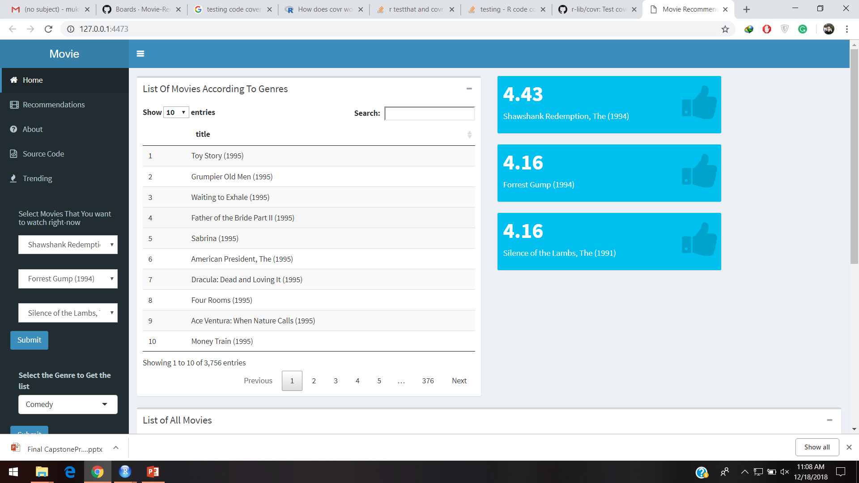
Screen Shots

Slide 8
